Slide 1
NEUR 608: Dimensionality Reduction
Bratislav Misic
McConnell Brain Imaging Centre
Montréal Neurological Institute
McGill University

Slide 2
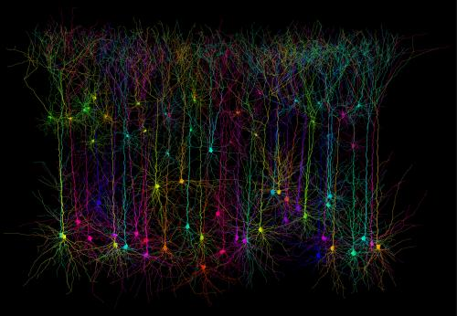
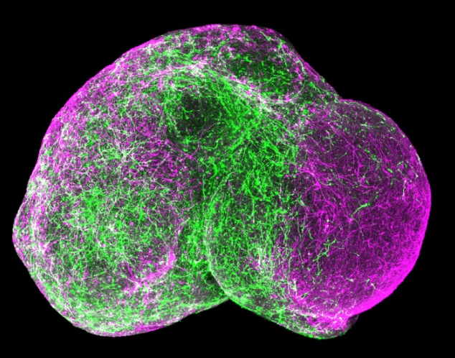
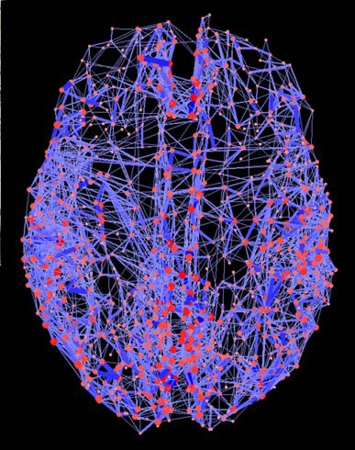

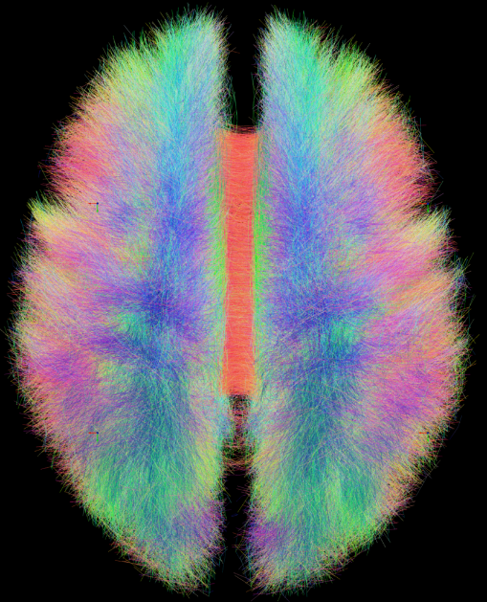
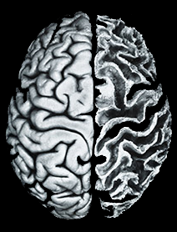
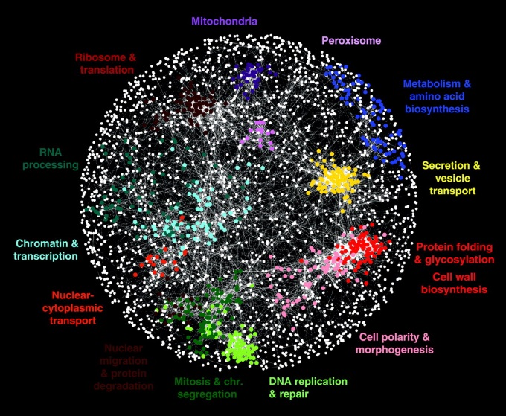
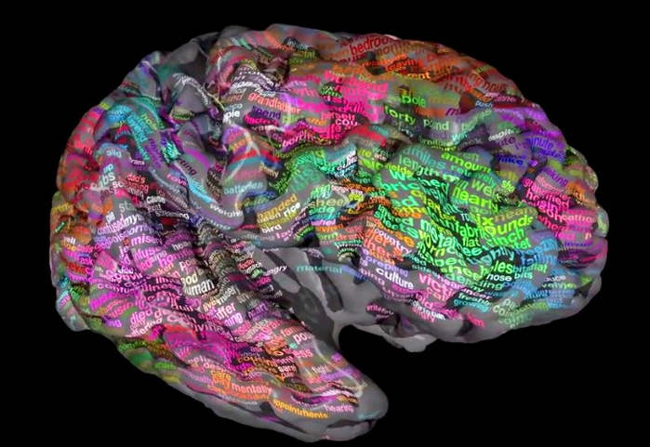
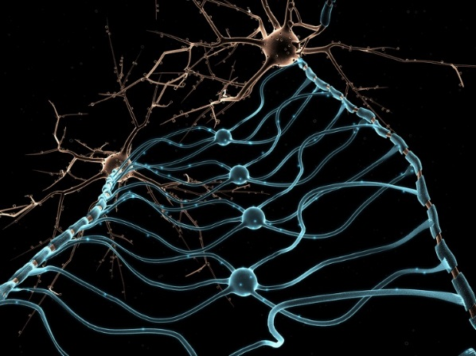
connectome

Slide 3
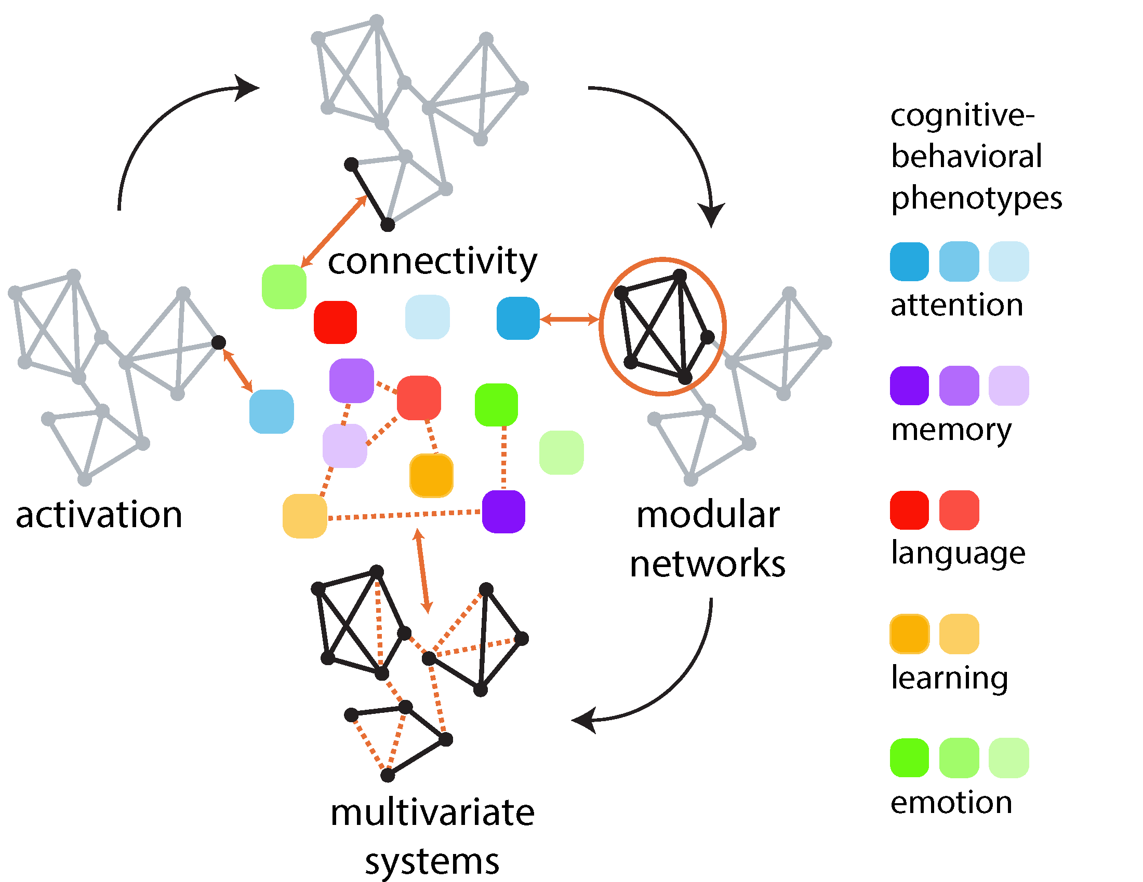
Towards multivariate analysis
activation: mapping individual elements to individual external variables
connectivity: mapping individual structural or functional connections to individual external variables
networks: mapping network attributes to individual external variables
multivariate systems: mapping patterns of elements or connections to patterns of external variables
Misic & Sporns (2016) Curr Opin Neurobiol

Slide 4
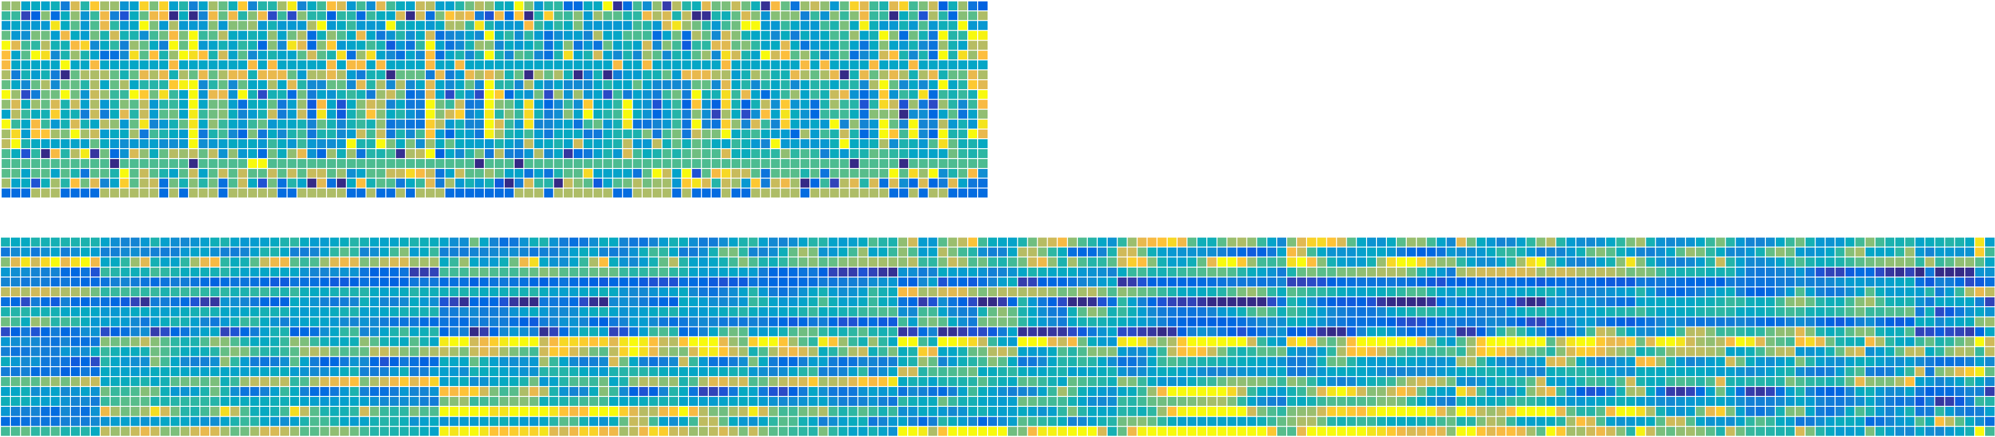
Integrating scales and modalities
variables
observations
variables
+
observations
How to deal with more variables than observations?
How to operationalize the network property?
How to relate multiple data sets to each other?

Slide 5
Lecture plan
Goal #1: why dimensionality reduction?
linear: PCA, FA, ICA, MDS
nonlinear: kernel PCA, LLE, diffusion maps, t-SNE, autoencoders
Goal #2: how is similarity expressed?
Goal #3: is there an underlying generative model?
Goal #4: statistical inference and reliability (and lack thereof)
Goal #5: examples + demo

Slide 6
Principal component analysis (PCA)
original variables x₁ and x₂ are correlated but neither captures the dominant pattern of variance
want a new variables z₁ and z₂ that (a) capture as much variance (b) are mutually uncorrelated
need to find a rotation u to re-align the original axes (variables)
u is chosen to maximize the variance of the new variables z
Hotelling (1933) J Educ Psychol

Slide 7
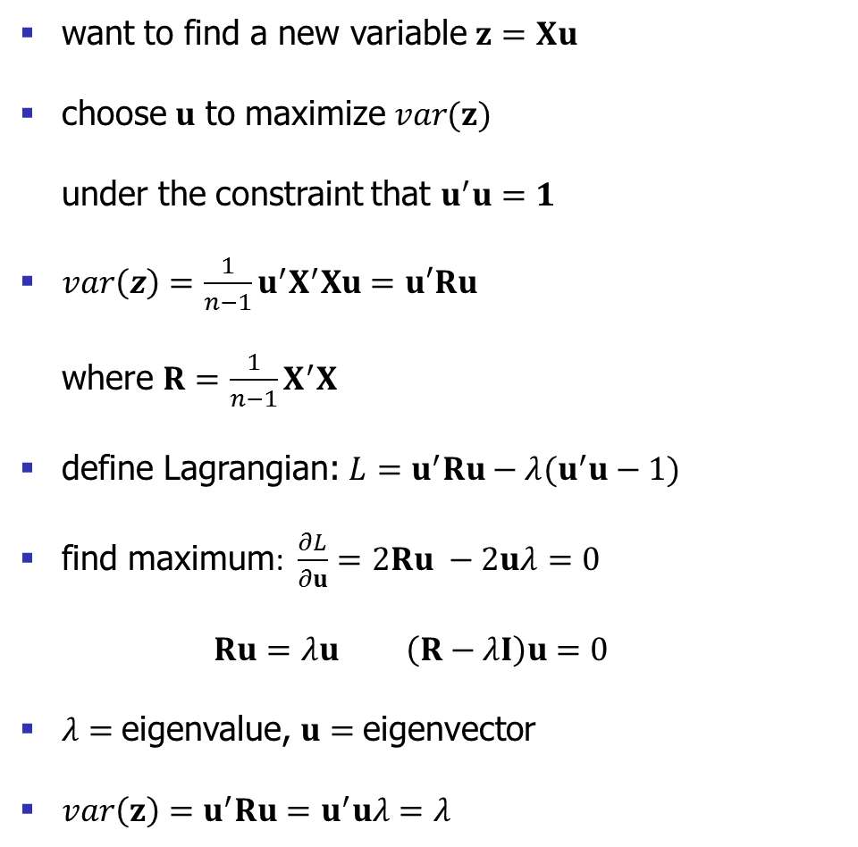
Maximzing variance
want to find a new variable $z=Xu$
choose $u$ to maximize $var(z)$ under the constraint that $u^{′}u=1$
$var\left(z\right)=\frac{1}{n−1}u^{′}X^{′}Xu=u′Ru$ where $R=\frac{1}{n−1}X^{′}X$
define Lagrangian: $L=u^{′}Ru−λ(u^{′}u−1)$
find maximum: $\frac{∂L}{∂u}=2Ru −2uλ=0$ $Ru=λu \left(R−λI\right)u=0$
$λ=$eigenvalue, $u=$eigenvector
$var\left(z\right)=u^{′}Ru=u^{′}uλ=λ$
Hotelling (1933) J Educ Psychol

Slide 8
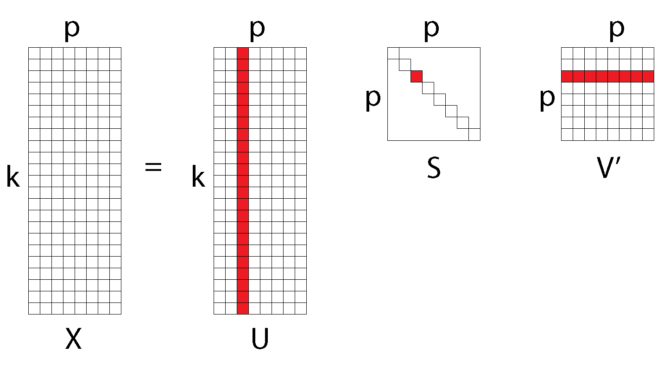
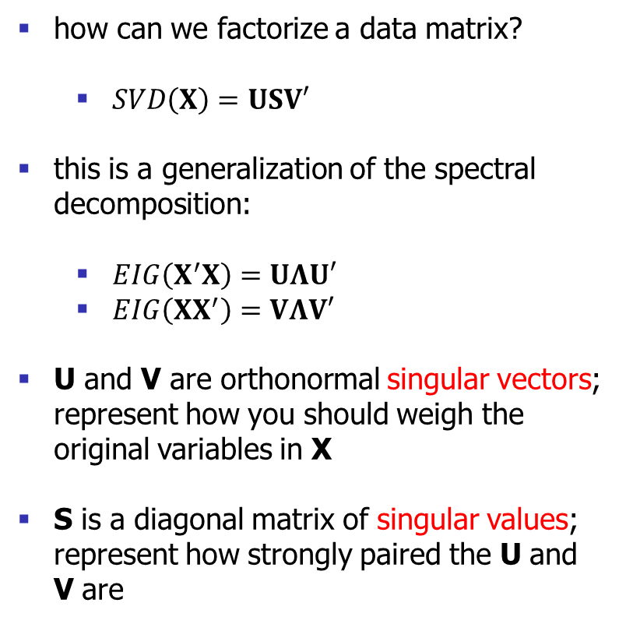
Singular value decomposition (SVD)
how can we factorize a data matrix?
$SVD\left(X\right)=USV′$
this is a generalization of the spectral decomposition:
$EIG\left(X^{′}X\right)=UΛU′$
$EIG\left(XX^{′}\right)=VΛV′$
U and V are orthonormal singular vectors; represent how you should weigh the original variables in X
S is a diagonal matrix of singular values; represent how strongly paired the U and V are
Eckart & Young (1936) Psychometrika

Slide 9
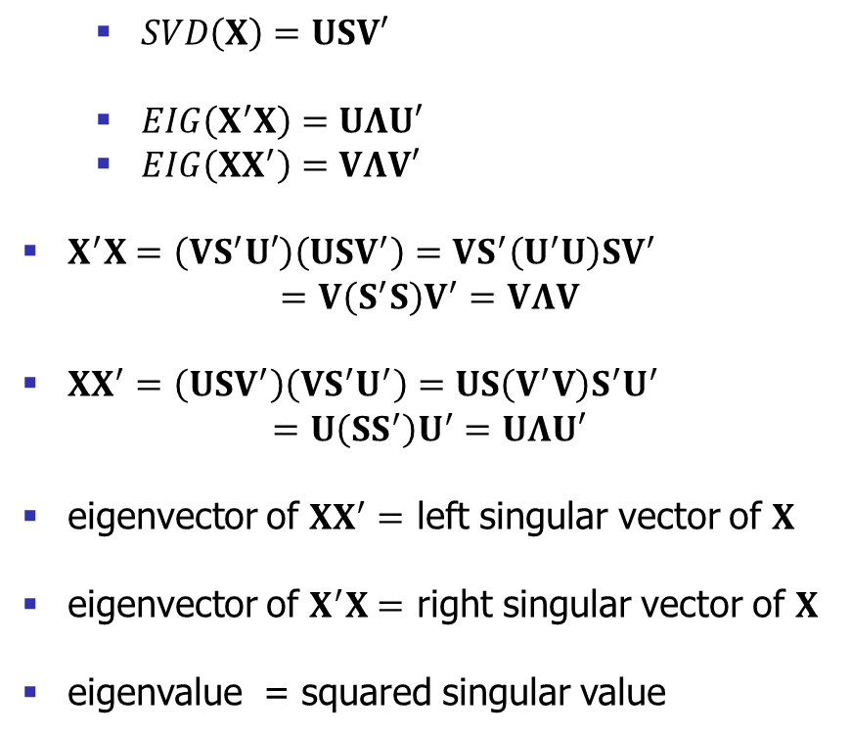
Singular value decomposition (SVD)
$SVD\left(X\right)=USV′$
$EIG\left(X^{′}X\right)=UΛU′$
$EIG\left(XX^{′}\right)=VΛV′$
$X^{′}X=\left(VS^{′}U′\right)\left(USV^{′}\right)=VS^{′}\left(U^{′}U\right)SV^{′}$ $=V\left(S^{′}S\right)V^{′}=VΛV$
$XX^{′}=\left(USV^{′}\right)\left(VS^{′}U^{′}\right)=US\left(V^{′}V\right)S^{′}U^{′}$ $=U\left(SS^{′}\right)U^{′}=UΛU′$
eigenvector of $XX^{′}=$ left singular vector of $X$
eigenvector of $X^{′}X=$ right singular vector of $X$
eigenvalue = squared singular value
Eckart & Young (1936) Psychometrika

Slide 10
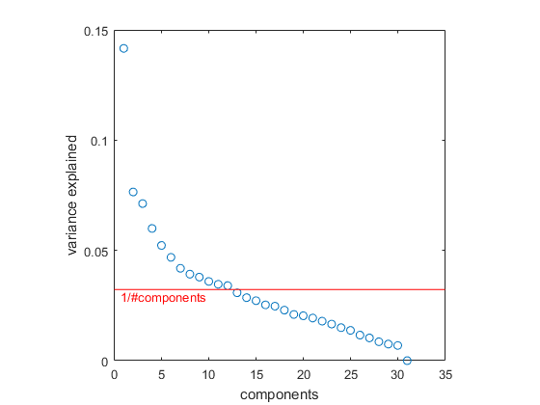
How many components to retain?
Kaiser criterion: drop all eigenvalues lower than 1
“elbow” rule: look for the biggest drop-off in the scree plot
Cattell (1966) Mult Behav Res
Thorndike (1953) Psychometrika

Slide 11
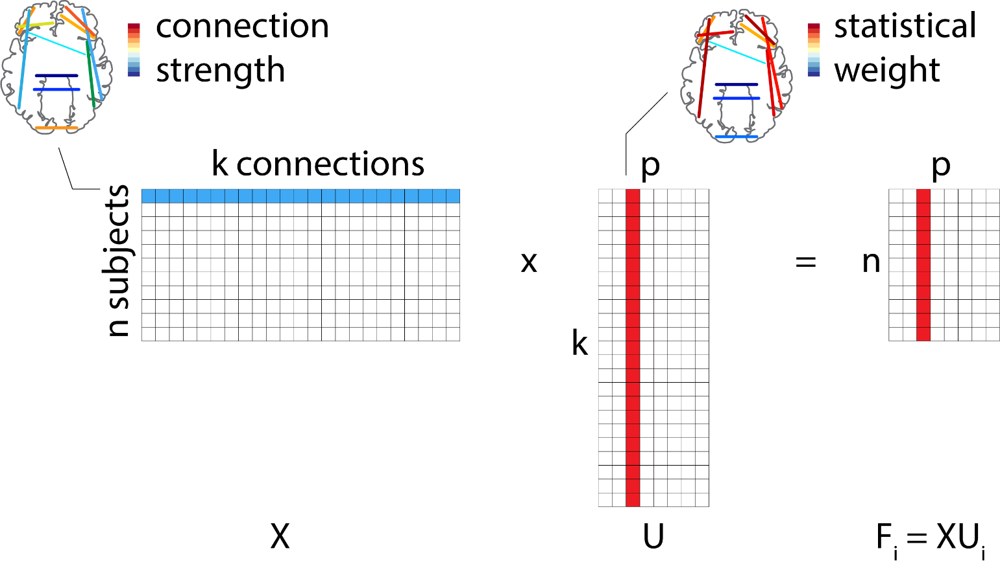
Individual participants
weights that tell us how much each variable (connection, region, behaviour) contributes to the pattern
but every participant is different – how do individual participants express the overall pattern?
participant scores – project original data onto the latent variables

Slide 12
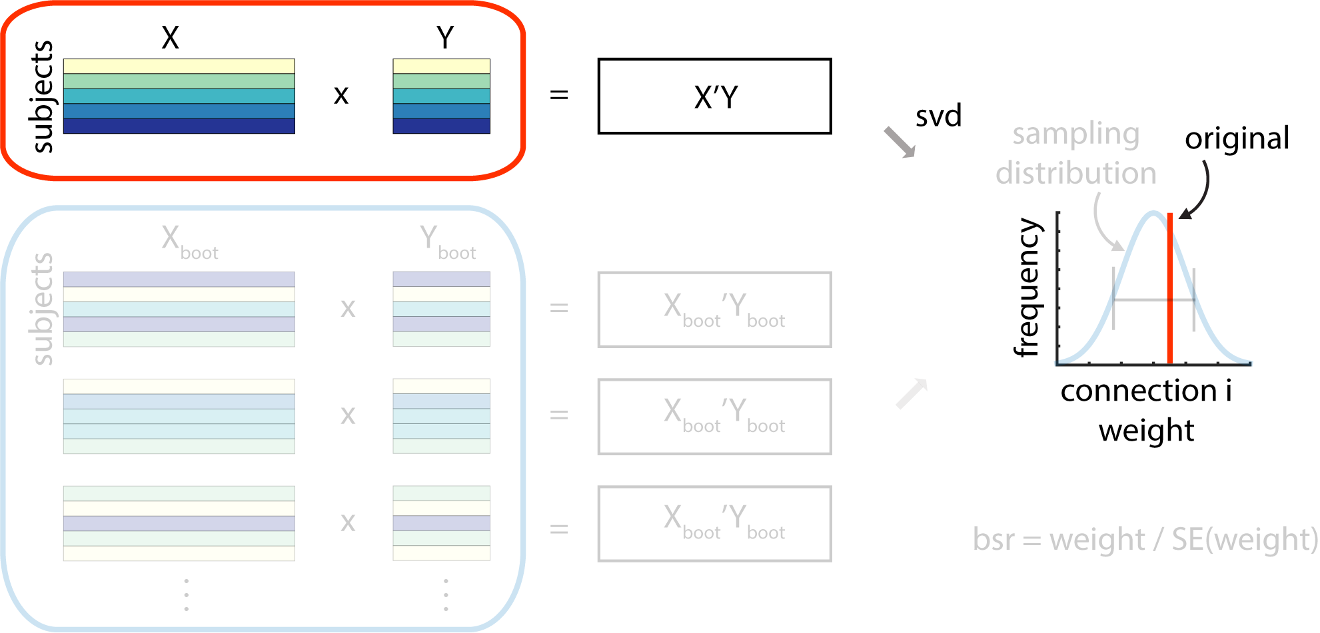
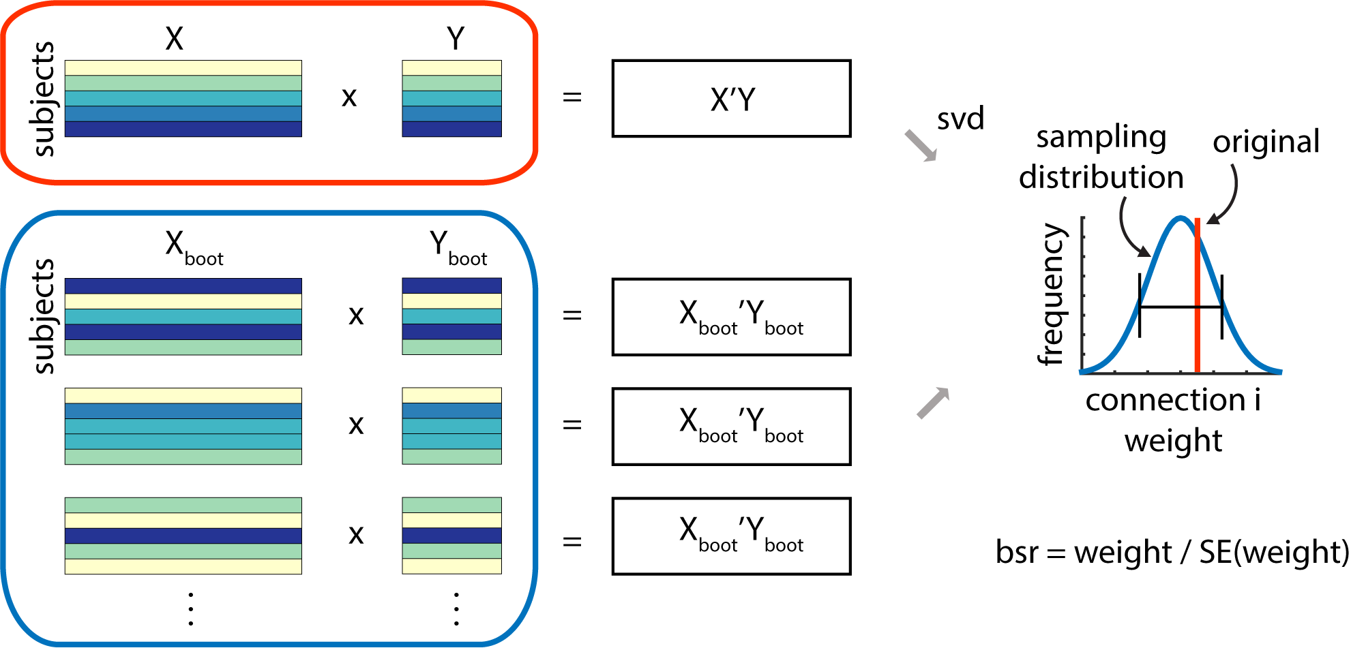
Which variables are important?
singular vector weight: how much should I weigh the variables?
loading: does expression of the original variable correlate with expression of the latent variable?
“bootstrap ratio”: which original variables are weighed highly but also stable across participants?
Efron & Tibshirani (1986) Stat Sci
McIntosh et al. (1996) NeuroImage

Slide 13
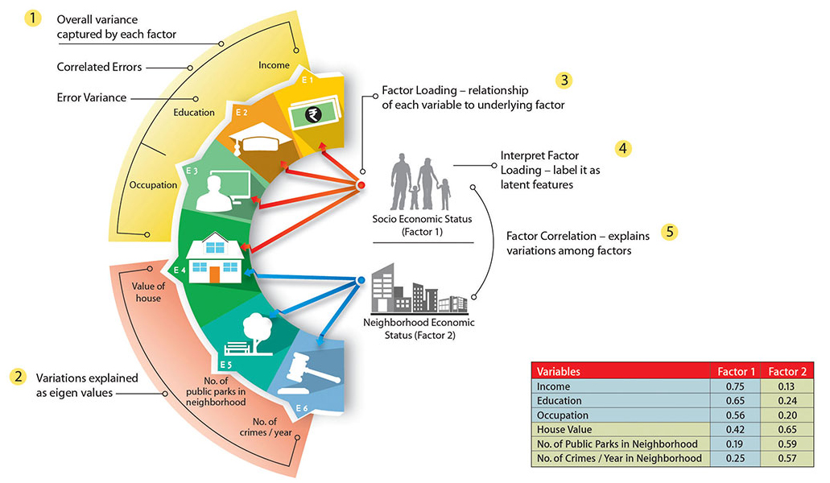
Factor Analysis (FA)

Slide 14
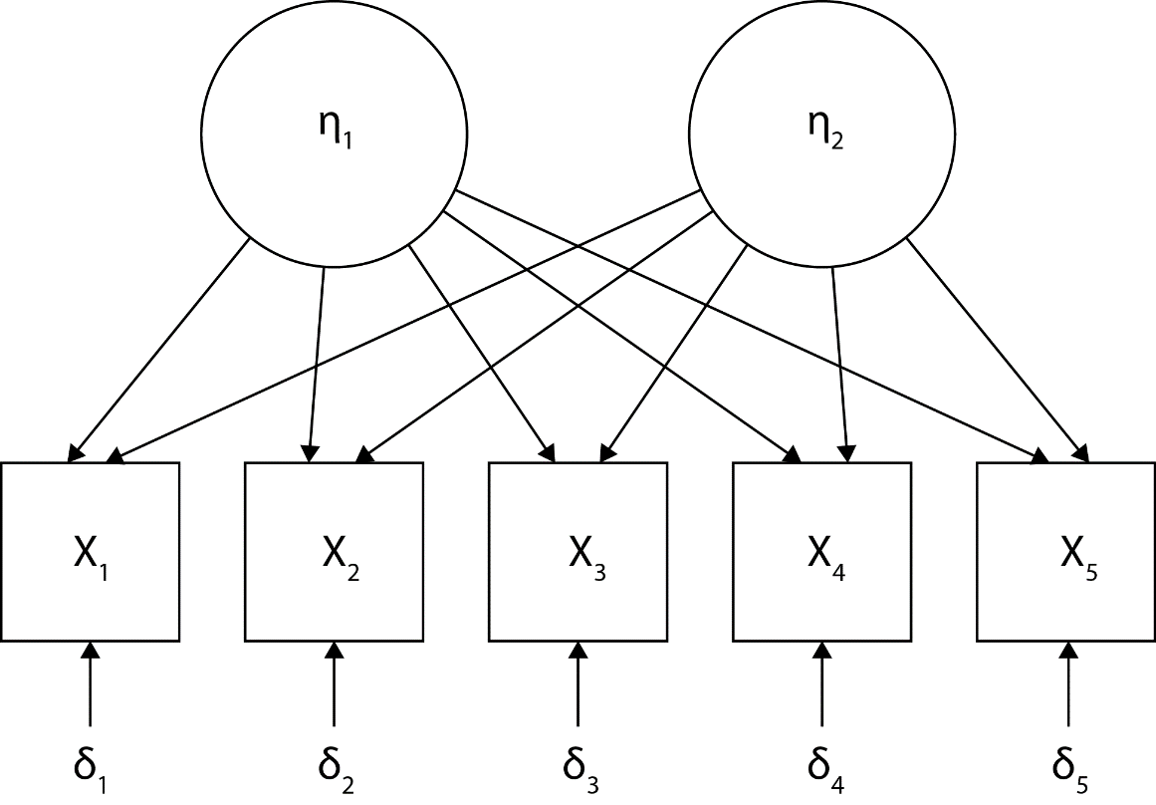
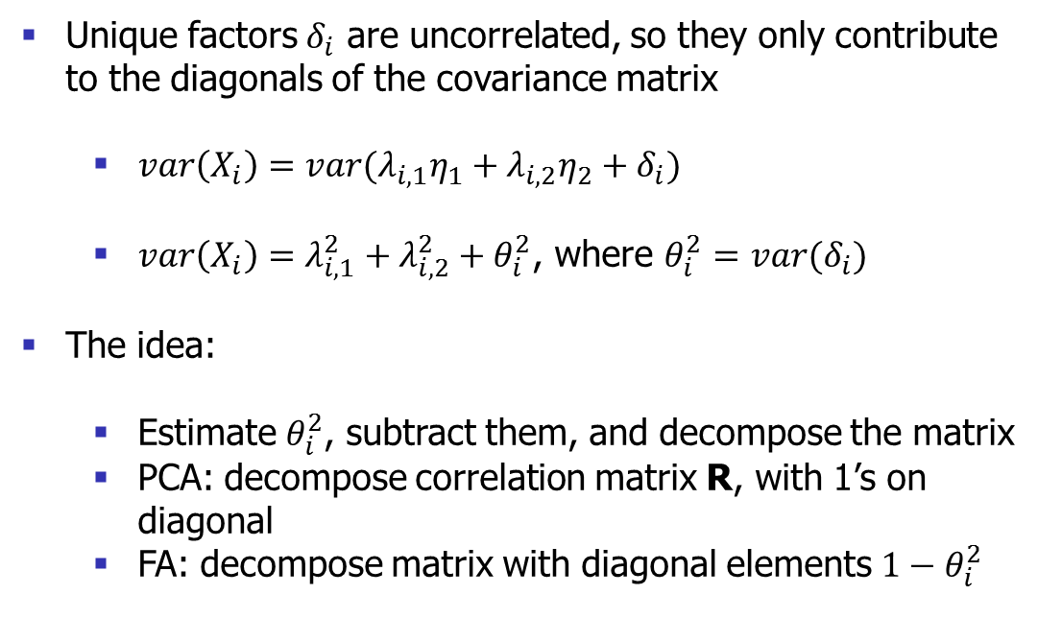
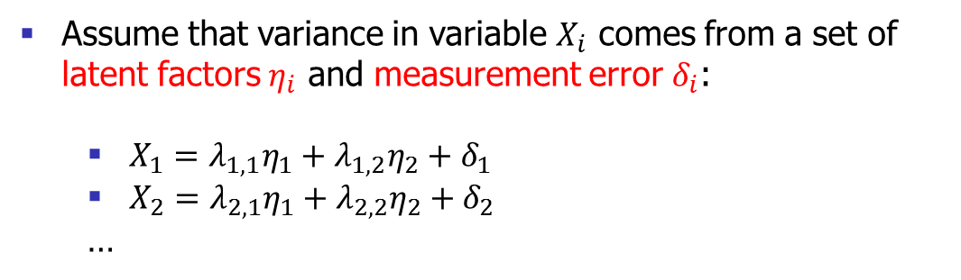
Factor Analysis (FA)
Assume that variance in variable $X_{i}$ comes from a set of latent factors $η_{i}$ and measurement error $δ_{i}$:
$X_{1}=λ_{1,1}η_{1}+λ_{1,2}η_{2}+δ_{1}$
$X_{2}=λ_{2,1}η_{1}+λ_{2,2}η_{2}+δ_{2}$
…
Unique factors $δ_{i}$ are uncorrelated, so they only contribute to the diagonals of the covariance matrix
$var\left(X_{i}\right)=var(λ_{i,1}η_{1}+λ_{i,2}η_{2}+δ_{i})$
$var\left(X_{i}\right)=λ_{i,1}^{2}+λ_{i,2}^{2}+θ_{i}^{2}$, where $θ_{i}^{2}=var(δ_{i})$
The idea:
Estimate $θ_{i}^{2}$, subtract them, and decompose the matrix
PCA: decompose correlation matrix R, with 1’s on diagonal
FA: decompose matrix with diagonal elements ${1−θ}_{i}^{2}$

Slide 15
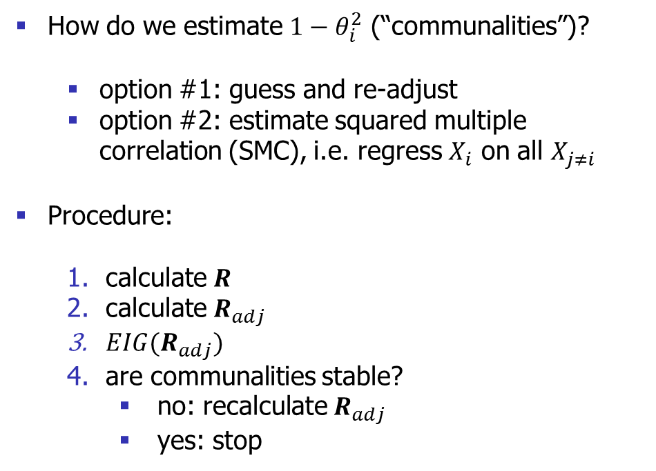
Factor Analysis (FA)
How do we estimate ${1−θ}_{i}^{2}$ (“communalities”)?
option #1: guess and re-adjust
option #2: estimate squared multiple correlation (SMC), i.e. regress $X_{i}$ on all $X_{j≠i}$
Procedure:
calculate $R$
calculate $R_{adj}$
$EIG(R_{adj})$
are communalities stable?
no: recalculate $R_{adj}$
yes: stop

Slide 16
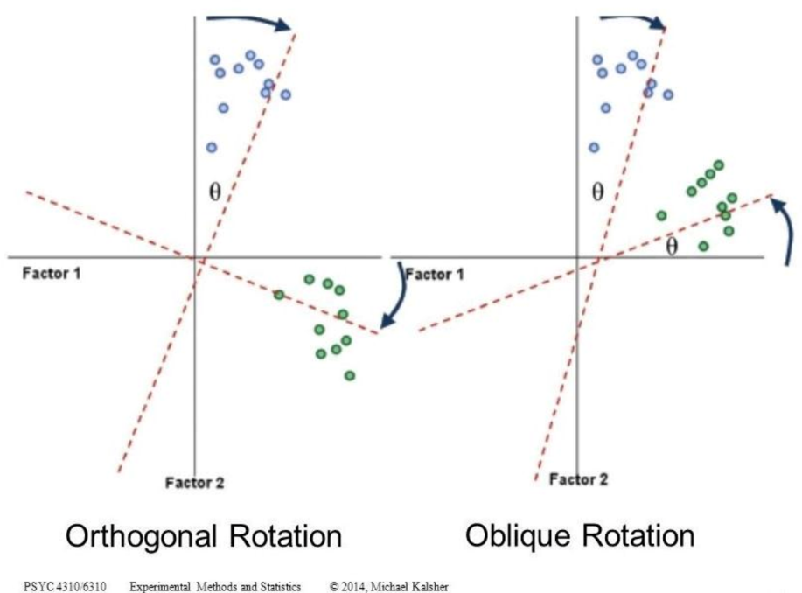
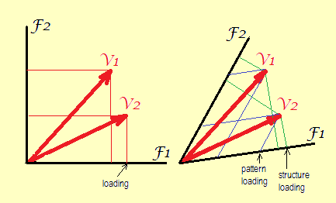
Factor Analysis (FA): rotation
We want to improve interpretability: each factor has high loadings on only a few variables, and near zero for all others
orthogonal: factors remain uncorrelated (e.g. varimax)
oblique : factors may correlate (e.g. promax, oblimin)
If we perform an oblique rotation, it is no longer obvious how to interpret factors:
structure loading
pattern loading

Slide 17
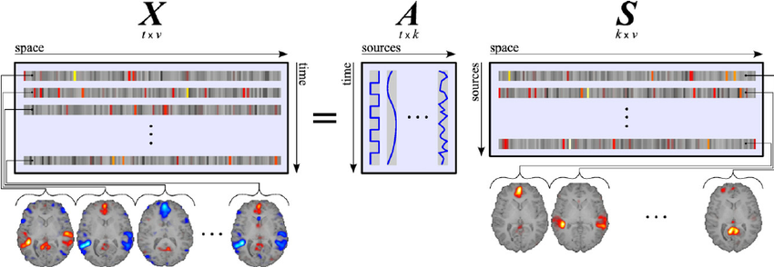
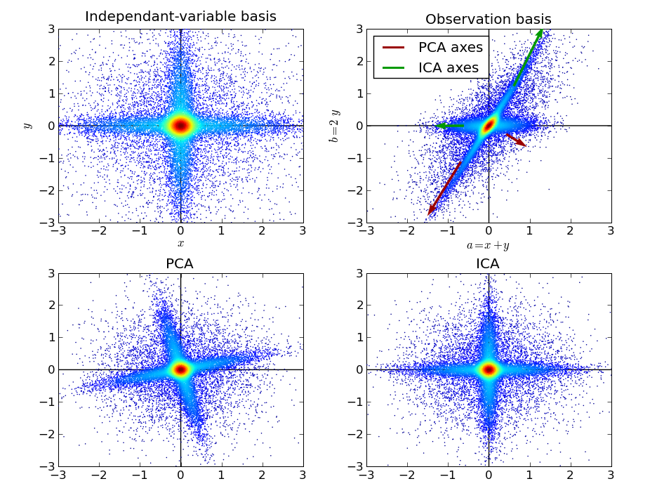
Independent Components Analysis (ICA)
Blind source separation
Assumption: there exist a finite number of sources (independent components) that are mixed to produce observed neural activity
Solution:
Any linear mixture of independent variables (e.g. voxels) will be more Gaussian than the original variables
Create new axes with maximally non-Gaussian projections
Many algorithms + objective functions
Ylipaavalniemi & Vigario (2008) NeuroImage
image: Gael Varoqaux

Slide 18
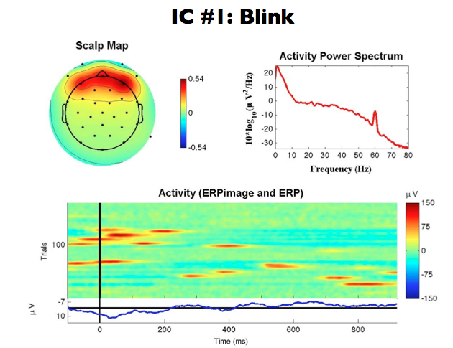
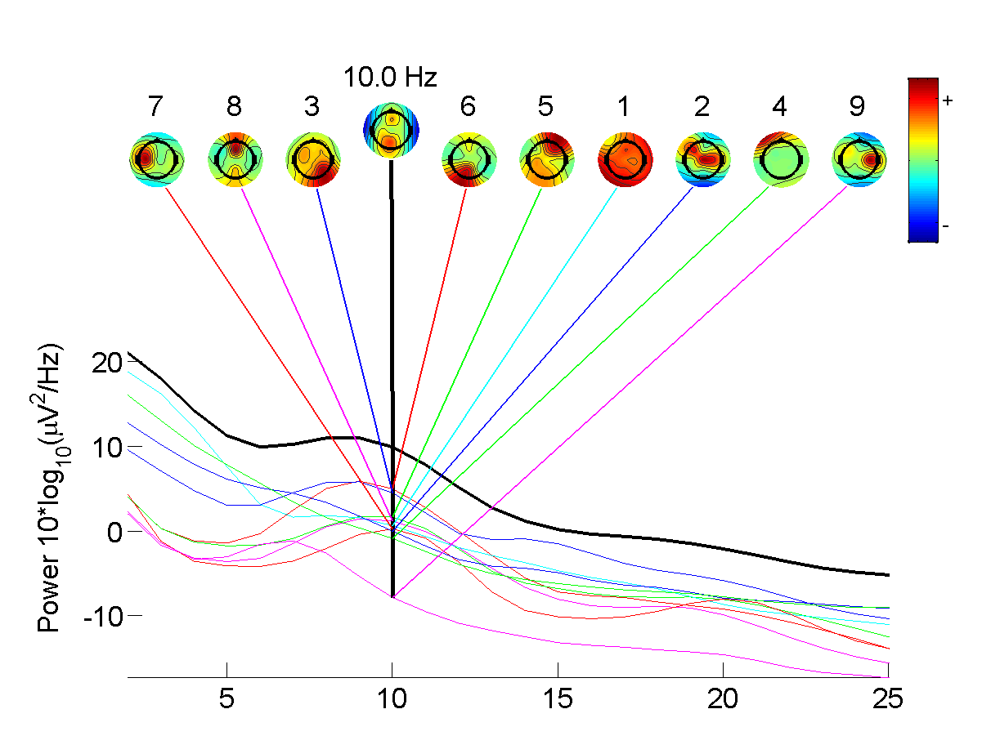
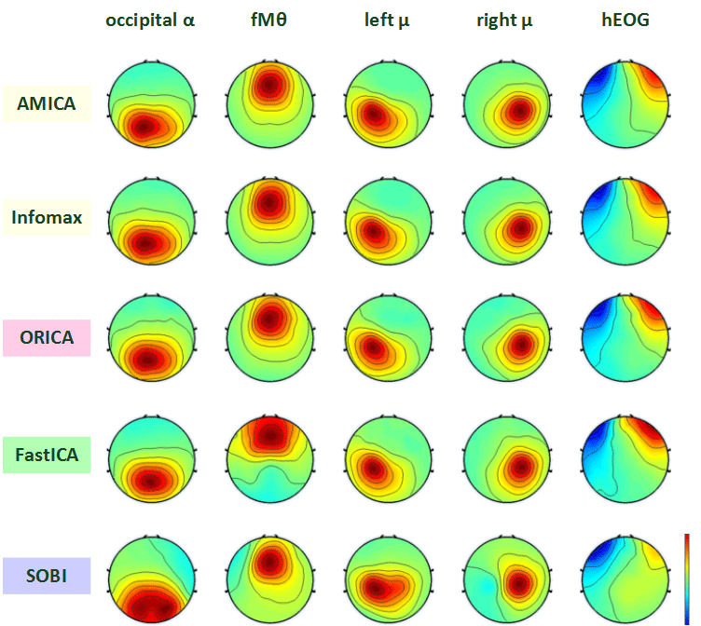
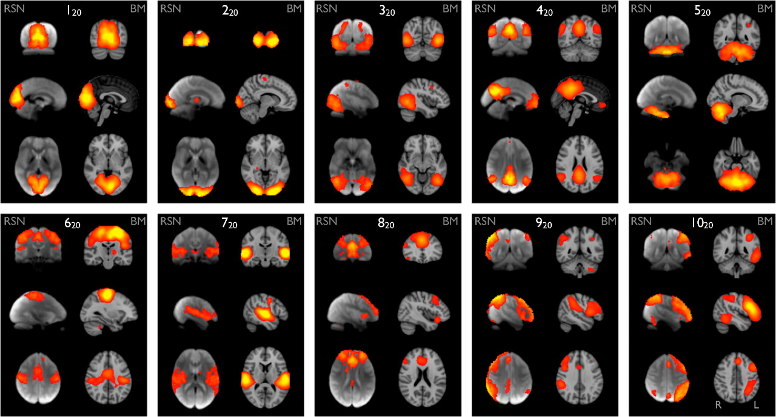
ICA in practice
Considerations:
Model selection
Starting point
Whitening
Algorithm
Subject- vs group-level
Spatial vs temporal independence
Used for both preprocessing and for discovery

Slide 19
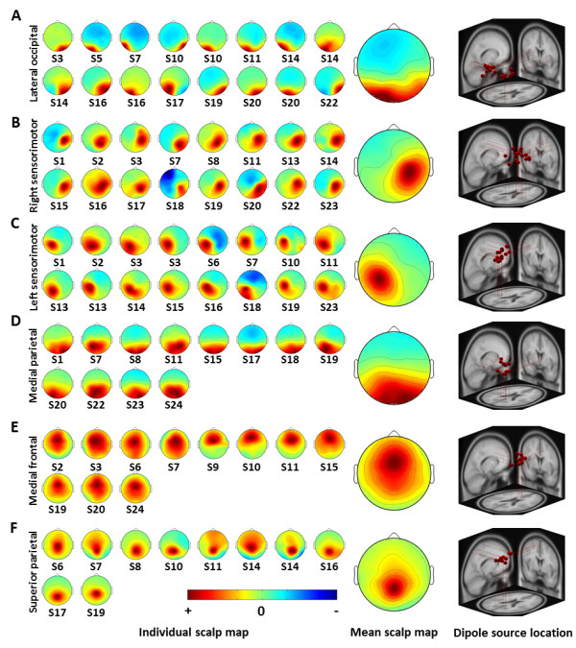
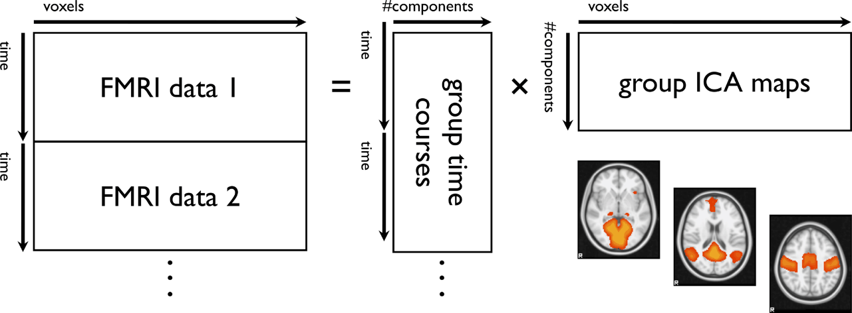
ICA: subject- vs group-level

Slide 20
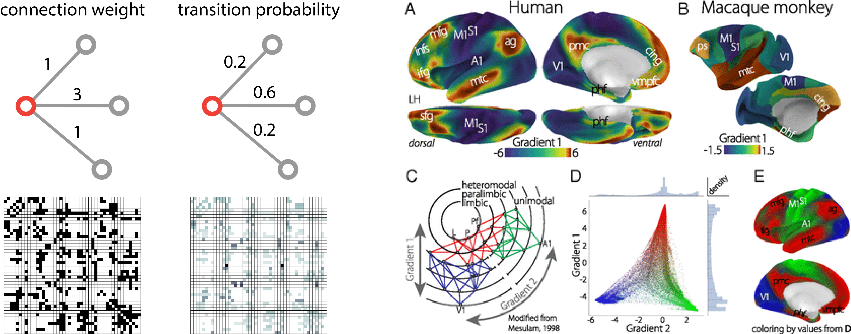
Diffusion embedding
Convert correlation matrix to a transition probability matrix
Compute diffusion operator (Laplacian):
Get eigenvectors and eigenvalues of Laplacian
The resulting components reflect dominant modes of diffusion
Points (e.g. voxels) are grouped by how close or accessible they are to each other by a random walker
Margulies et al. (2016) PNAS

Slide 21
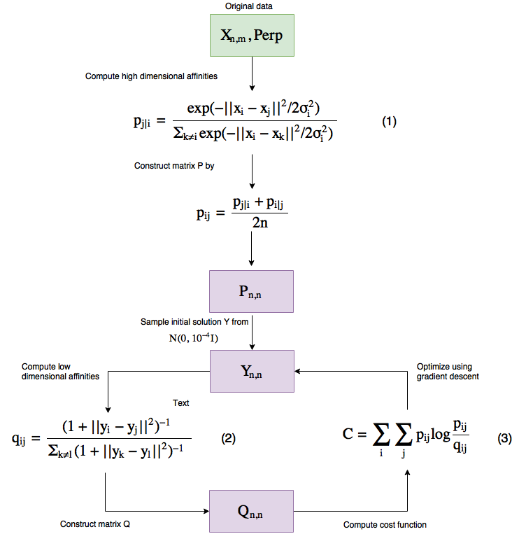
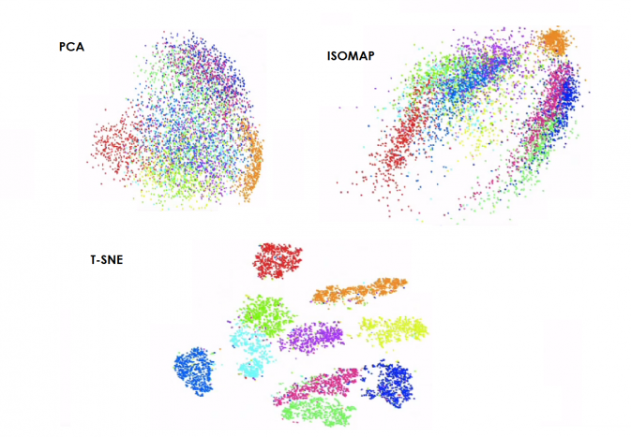
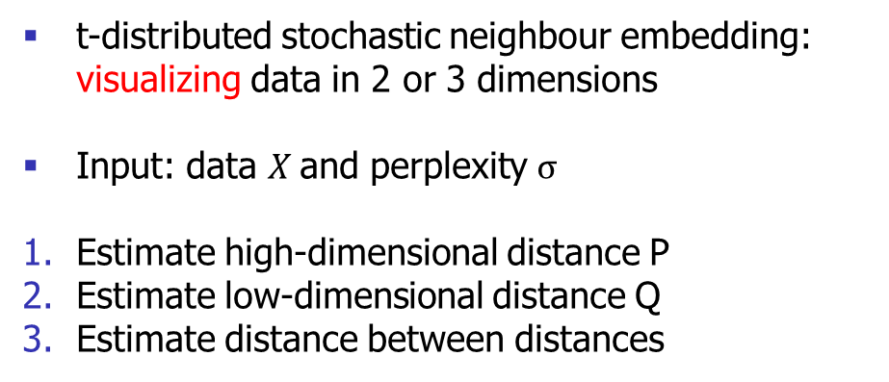
t-SNE
t-distributed stochastic neighbour embedding: visualizing data in 2 or 3 dimensions
Input: data $X$and perplexity $σ$
Estimate high-dimensional distance P
Estimate low-dimensional distance Q
Estimate distance between distances
van der Maaten & Hinton (2008) J Mach Learn Res

Slide 22
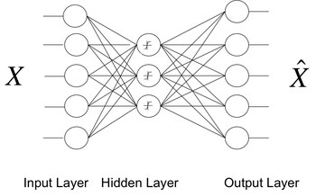
Autoencoders
Idea: input and output layers have the same number of nodes (i.e. equal to the number of variables), but hidden layers with fewer nodes
The neural network has to efficiently encode and then reconstruct the input
Typically feedforward, non-recurrent
If activations are linear, autoencoders will approximate SVD (Bourlard & Kemp, 1988)

Slide 23
Limitations and Considerations
Overfitting
Linear or nonlinear?
Identifiable?
Unique partitioning of variance
Inference on individual variables

Slide 24

Demo: PPMI
Parkinson’s Progression Markers Initiative (http://www.ppmi-info.org)
Deep phenotyping in patients with Parkinson’s disease
n = 232 de novo patients
p = 31 clinical, demographic and physiological variables
Question: can we feasibly reduce this 31-dimensional dataset? Can we find dominant latent patterns?
Marek et al. (2011) Prog Neurobiol

